Slide 1
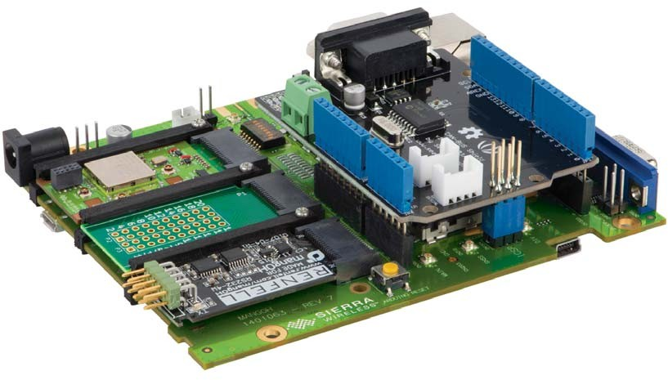

MangOH Green
WeeK 1
Reporter: Trong Phuoc
MENTOR: NgUYEN XUAN THONG

Slide 2
1) Introduction
MangOH Green is designed for prototyping and industrial-grade wireless product.
Specification of MangOH Green:
Adaptive hardware: mangOH green can add any combination of wire or wireless hardware: Bluetooth, CAN, USB, Wifi, LAN, ZigBee,.., Arduino can be connect with mangOH board to expansion possibility in many applications.
Open Source Software: mangOH use open source Legato Linux platform. The automatic load necessary drivers to turn on IoT connector or Arduino shield, so developer can receiving or sending data.

Slide 3
1) Introduction
Cellular connectivity: mangOH Green can connect to any type 2G 3G, 4G network in the world with the CF3 base wireless modules from Sierra Wireless via APIs of Legato platform(enable voice call, SMS text message or data path).
Cloud services: MangOH Green delivers sensor data to the cloud (air Vantage) with built in library securely. Application in mobile can get information from cloud to their device.

Slide 4
2) Hardware
a) Power supply
-DC Power: maintain a full speed mobile network data connection.
- USB Power
- Baterry: An optional Li-Ion or Li-polymer (3V7 nominal) rechargeable battery can be installed to power the board if the primary power supply fails.
User select power supply via jumper in MangOH board.

Slide 5
2) Hardware
b) mangOH Green Hardware Architecture
The mangOH Green platform provide several hardware component:
CF3 module socket(main and secondary).
Pluggable IoT connector.
Integrated Arduino-compatible circuit with an on-board ATmega32U4 microcontroller.
Several I/O connectors (SIM, SD, Audio, USB, Ethernet, etc.).

Slide 6
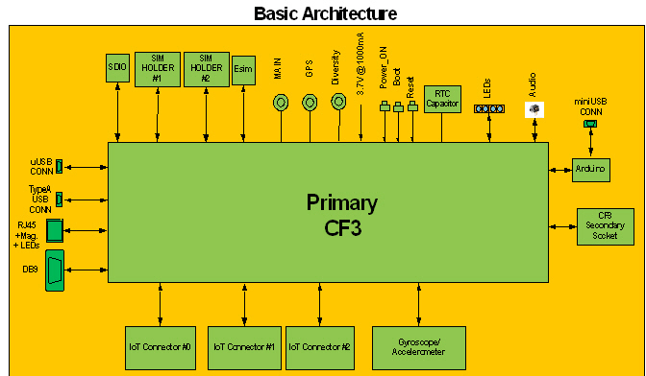

Slide 7
2) Hardware
c) CF3 module
CF3 (Common Flexible Form Factor) modules power all mangOH designs adding application processing, wireless connectivity, and GNSS tracking and positioning.
Primary module: Used in the primary CF3 socket, the module includes a cellular modem and an application processor running Legato, an open source embedded platform built on Linux for hosting IoT applications.
Secondary(optional): the module includes a cellular modem that must be associated to an application processor in the primary CF3 socket.

Slide 8
CF3 module in mangOH green:
Wireless Technology: 2G, 3G.
Application Processing: Cortex-A5 Memory: NAND Flash - 512 MB, DDR - 256 MB.
Modules such as ADC, UART, SPI, I2C, USB 2.0, GPIO, Ethernet, RF.

Slide 9
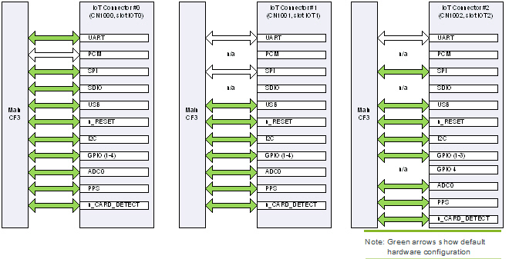
2) Hardware
d) IoT Connection
The mangOH Green provides three IoT Connectors (in slots IOT0, IOT1, and IOT2). IoT connectors provide plug and play wire, wireless, sensor connectivity.

Slide 10
2) Hardware
e) Arduino-compatible Circuit
The mangOH Green includes an integrated Arduino-compatible circuit (with connector for use with Arduino-compatible shields, and an Atmega32U4 microcontroller).
By default, the Arduino-compatible circuit’s UART is configured to connect to the primary CF3 module‘s USB using an FTDI conversion chip (UART to USB).
The Arduino-compatible circuit can also be accessed from the primary CF3 module.

Slide 11
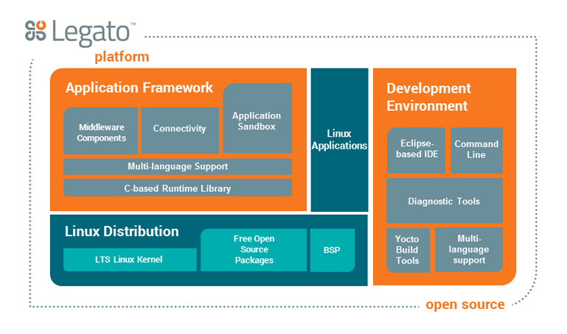
3) Legato Platform

Slide 12
3) Legato Platform
a) Application Framework
The Legato Application Framework is set of tools that enable developers to focus on building application, it simplifies the complexity of interfacing with the underlying OS and hardware.
The Legato Application Framework provides:
A library of Legato that provides many APIs to enable low-level routines and commonly used data structures and OS service APIs.
Core Daemons that provide secure services to run and manage your applications.
A set of Command Line Tools for both your target and your development machine to ease the configuration and administration of deploying applications and configuring your target device.

Slide 13
3) Legato Platform
b) Platform service
The Legato Application Framework works with a supporting platform to connect your applications to the cloud. User Applications, Platform Services, Platform Adapters and the Application Framework are built into a Runtime Environment that provides a cohesive system to run and monitor your applications and send and receive data from external sources.
Platform service: supply service like locating sensing, audio connection, network connection into application.
Platform Adapter: library that provide functionality for hardware and OS functions.

Slide 14
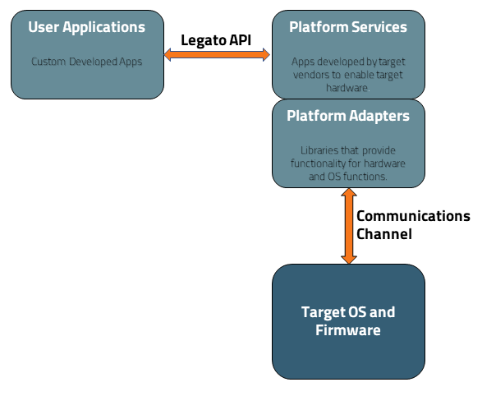
Legato Services Flow

Slide 15
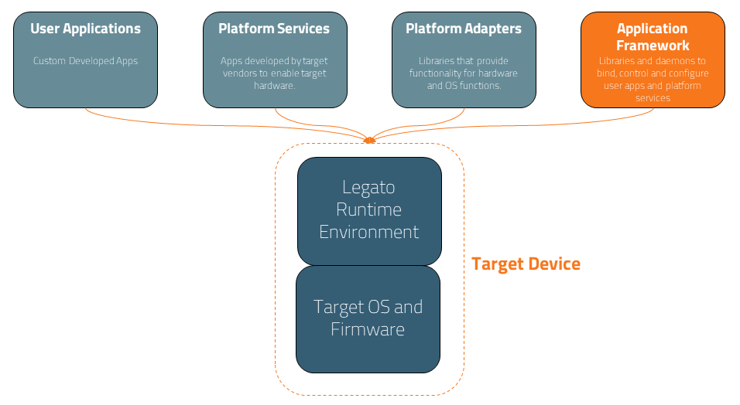
Legato Target

Slide 16
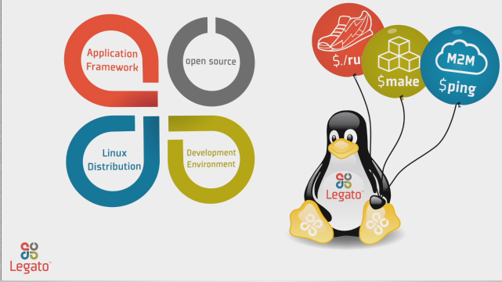
3) Legato Platform
c) Linux distribution
Sierra Wireless provides embedded Linux BSPs that include customizations features. The Linux BSP was created using the tools, templates and methods developed by the Yocto Project.

Slide 17

4) Application Files Structure

Slide 18
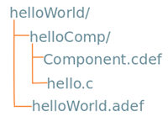
4) Application Files Structure
An *.adef file is used to describe all resources required to build a Legato App.
Component.cdef is definition file that describe how to build the Component.
Hello.c is a source file of this app.

Slide 19
5) Reference
[1]. mangOH Fundamentals—Linux Computer.
[2]. mangOH Green User Guide/ Developer ‘s Guide.
[3]. Youtube: IoT open source hardware platform, mangOH™ Green.
[4]. Youtube: Legato, open source embedded platform built on Linux.
[5]. Getting started with mangOH(Linux computer + Legato CLI).
[6]. mangOH website: Basic tutorials.

Slide 20
6) Issues
Building Legato.
Communication protocol of camera.
How to develop driver for camera.

Slide 21
7) Summary
Introduction about hardware/specification of mangOH Green.
Legato Platform.
Application structure.
Issues.

Slide 22


